Slide 1
Cognitive Search and Augmentation Combining Microsoft Cognitive Services and Azure Search
Luis Cabrera
Principal Program Manager Content and Search Intelligence

Slide 2

We learn and use technology.
Technology learns us and discovers ways to be helpful.
Coordinating
Answering
Observing
Anticipating
Listening
Notes:
Humans are at the center—we think AI will augment the work that humans are doing. We have Cortana (for consumers), Cognitive Services and Bot Framework (for developers), and Machine Learning (for businesses).

Slide 3

Paul
Microsoft AI
AI SERVICES
AI TOOLS
CONVERSATIONAL AI
TRAINED SERVICES
CUSTOM SERVICES
Bot Framework
Cognitive Services
Azure Machine Learning
CODING & MANAGEMENT TOOLS
VS Tools for Machine Learning
Azure ML Studio
Azure ML Workbench
AI INFRASTRUCTURE
Others (Pycharm, Jupyter notebooks…)
AI ON DATA
AI COMPUTE
DEEP LEARNING FRAMEWORKS
Cosmos DB
SQL
DB
SQL
DW
Data Lake
Spark
DSVM
Batch AI
ACS
Edge
Cognitive Toolkit
TensorFlow
Caffe
CPU, GPU, FPGA
Others (Scikit-learn, MXNet, Keras, Gluon…)

Slide 4






Microsoft Cognitive Services
Give your apps a human side
Vision
From faces to feelings, allow your apps to understand images and video
Speech
Hear and speak to your users by filtering noise, identifying speakers, and understanding intent
Language
Process text and learn how to recognize what users want
Knowledge
Tap into rich knowledge amassed from the web, academia, or your own data
Search
Access billions of web pages, images, videos, and news with the power of Bing APIs

Slide 5
Microsoft Cognitive Services
Give your apps a human side
Computer Vision
Content Moderator
Emotion
Face
Video
Video Indexer
Custom Vision Service
Bing Speech
Speaker Recognition
Custom Speech Service
Bing Spell Check
Linguistic Analysis
Text Analytics
Translator Text & Speech
Web Language Model
Language Understanding
Academic Knowledge
Entity Linking
Knowledge Exploration
Recommendations
QnA Maker
Custom Decision Service
Bing Autosuggest
Bing Image Search
Bing News Search
Bing Video Search
Bing Web Search
Bing Entity Search
Bing Custom Search
Vision
Speech
Language
Knowledge
Search

Slide 6
Enriching content through Cognitive Services
Demo

Slide 7
Analyzing text
Text Analytics
Language: English
Sentiment: Positive
Key Phrases : dozen epic, amazing travels, Aspirin, Ibuprofen, long working relationship, decades, Matthew Henson, Peary, valet, North Pole
Matthew Henson was born in 1866. Peary hired him as a valet, and the two began a long working relationship that spanned half a dozen epic and amazing travels over two decades. In 1887, it was not easy to access Aspirin or Ibuprofen, think how challenging it might have been reaching the North Pole.
"entityTypeHints": [ "Person" ],
"entityTypeDisplayHint": "Explorer"
Entity Linking Intelligent Service
Entities Identified
"entityTypeHints": [ "Drug"
Bing Entity Search API
Entities Type
"entityTypeHints": [
"Place"

Slide 8
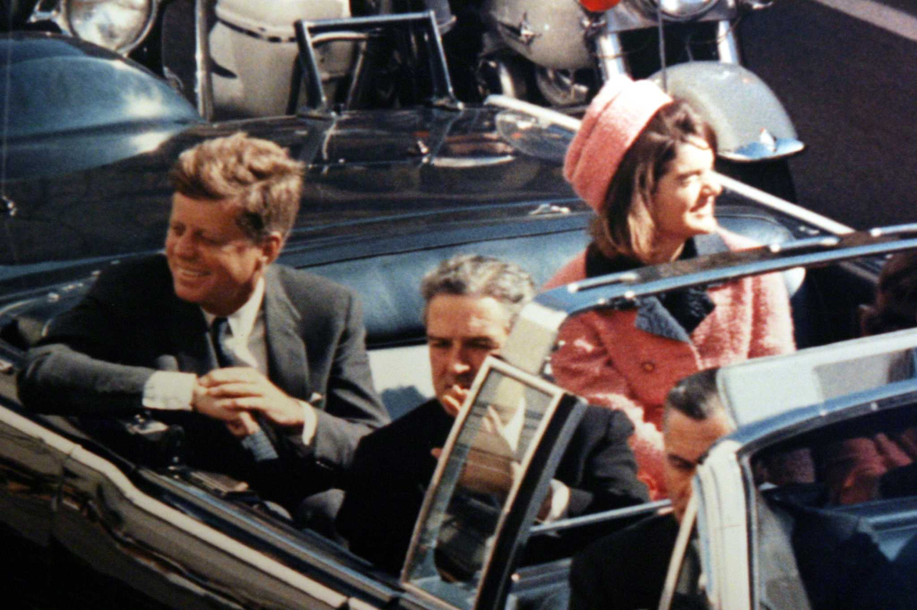

John F. Kennedy (JFK)
November 22, 1963

Slide 9
How do we do this?
Ingest
Enrich
Explore

Slide 10


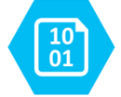
Ingest
Enrich
Explore
Cognitive Skills
Data Feed
Search
Annotations
Cognitive Search Pattern
Notes:
Skills produce knowledge in the form of annotation that are stored

